Slide 1
EMPLOYEE INTRODUCTION

Slide 2
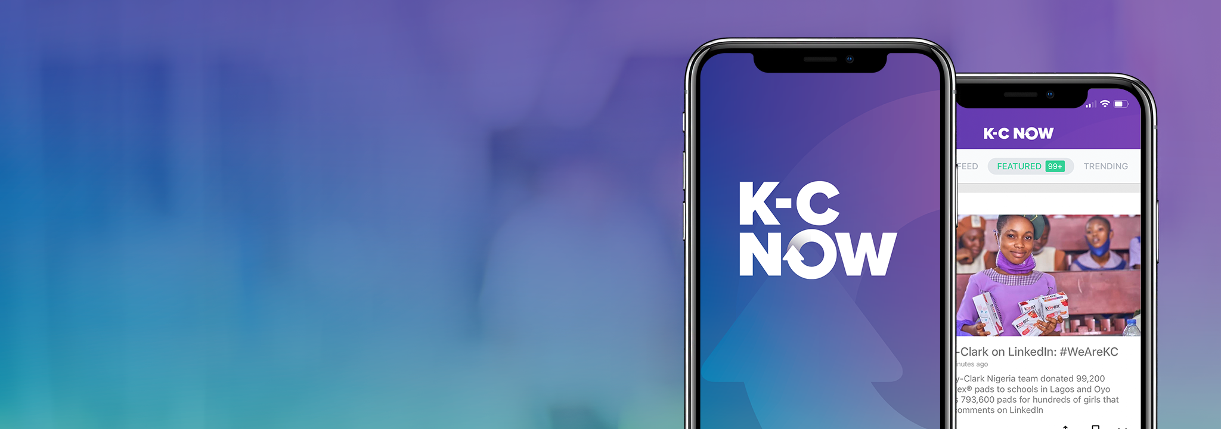
A modern digital experience for all K-C employees to learn, connect, and engage.
Inclusive - reaches every employee
Convenient - find what you need quickly
Fast - stay up-to-date in a matter of minutes
Relevant - content tailored to you
Easy - no training required

Slide 3
WHY IT IS IMPORTANT
When employees understand K-C’s strategic direction and their connection to it, engagement increases, and so does business performance.
Today, mobility, personalization, and accessibility are expected in our everyday user experiences.
Thanks to K-C NOW we found a way to share information in a faster, simpler and customizable way.
We are now able to reach EVERY employee, no matter where they are - home, office, or mill - with the right content, at the right time, on the devices they prefer.
You can now tailor your news feed according to your interests and find all important information in one place.

Slide 4
K-C NOW has purpose and integrates into our Digital Channel Ecosystem
LEARN, CONNECT, ENGAGE
Receive company news and important information and engage with fellow K-C'ers via mobile app and web.
Email, calendaring and managing tasks
Project and document collaboration, and chat, voice, video meetings
K-C’s internal social network - post ideas, questions, learnings and stories
K-C’s intranet for job-related resources, policies, and tools
Job-related resources and collaborative cloud file storage

Slide 5
ROADMAP
Phase I
Phase II
Phase III
From April 13, 2021
Late 2021
Future State
All global salaried employees can access K-C NOW
Expand to global hourly employees in early 2022 by first piloting in selected mills
Deliver targeted content
Increase employee submitted content
Test and maximize functionality

